Slide 1
STEAM Academy of Warren
Fall Learning Options
2020-2021
July 23,2020 at 11:30 am

Slide 2
Introduction to ACCEL Schools

Slide 3
ACCEL Schools
Established 2015
Division of Pansophic Learning
US Charter School Management
Greenfields, Takeovers, Turnarounds
hybrid learning
Schools are individualistic
45+ Schools
15,000+ Students

Slide 4
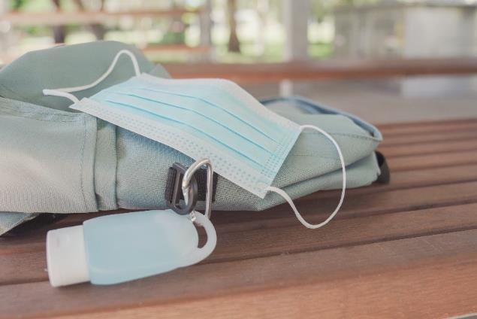
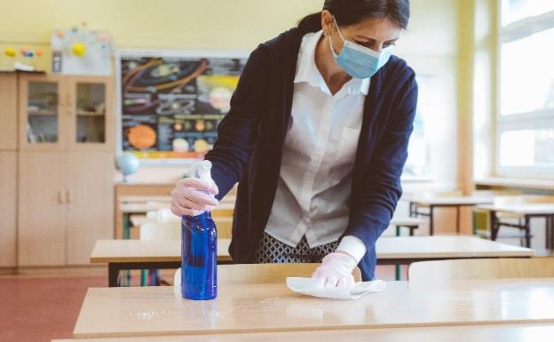
ACCEL Schools
ACCEL Schools is an established network of over 50 traditional, virtual, and hybrid schools that operates K-12 schools in ﬁve states. As part of the ACCEL Schools family, STEAM Academy of Warren beneﬁts from critical expertise and resources such as online coursework, learning management systems, parent communication tools, best practices in hybrid learning, and professional development for teachers.

Slide 5
Add logo
Introduction to School Name
Tuition-Free (K-8) School of Choice

Slide 6
Leadership Team for Steam Academy of Warren
Principal: Jon Natko
Assistant Principal: Eric Hall
Director of Academics: Maura Brewster
Office Manager: Ruby Luque

Slide 7
OUR FOCUS
College-Bound.
From the first day of Kindergarten our scholars know that they are preparing for college.
Giving Back.
Our scholars learn the importance of community service and improving the world around them at a young age.
Scholars for Life.
We equip our scholars with skills that will ensure a lifetime of success.

Slide 8
Why families choose STEAM Academy of Warren
Fall 2019-Winter 2020 grades 5-8 made over expected growth on NWEA Language expected usage
2018-2019 82.8% of 3rd graders passed 3rd grade Reading Guarantee compared to 54% passing the TGRE promotion threshold in 2017-2018 school year.
2016-2018 increased PI by 5 points each year.
2017-2019 increased 7th grade Air Math Test by 30.8%.
2018-2019 increased 7th grade proficiency rate by 21% in ELA.
8th grade ELA/Math increased by 12%.
2018-2019 increased 5th grade math proficiency scores 19%.
2017-2020 FTE increased by 30%.

Slide 9
ACCEL Schools Learning Options

Slide 10
ACCEL Schools Fall Learning Options
TRADITIONAL
ONLINE
HYBRID
Notes:
Unusual times call for unique solutions. This is one of those times. Accel feels strongly that all families deserve a choice in their child’s learning platform due to the circumstances of the pandemic. Families should be able choose from the three delivery methods while remaining enrolled in the same school. They also deserve the opportunity to adjust their choice at certain points throughout the school year to best accommodate their family needs..

Slide 11
TRADITIONAL
In-person learning at the school building with added safety protocols and procedures.
INSTRUCTION
5 days per week at school, following safety guidelines
TEACHERS
Certified classroom teachers
SCHOOL ACTIVITIES
Sports, clubs, events & fields trips will be planned according to the Governor’s guidelines for schools
TECHNOLOGY & INTERNET
Classroom technology
TRANSPORTATION
Routes and availability will be communicated once known from district transportation department
FREE BREAKFAST AND LUNCH
Eat Meals at school

Slide 12
Online
At-home learning supported by teachers, technology, and curriculum speciﬁcally built for online learning.
INSTRUCTION
5 days per week at home
TEACHERS
Certified teachers supported by parents
SCHOOL ACTIVITIES
Access to school based extracurricular activities as scheduled by the school, in accordance with the Governor’s guidelines for health and safety.
TECHNOLOGY & INTERNET
School loaned computer as needed and available
Internet reimbursement based on eligibility and participation
TRANSPORTATION
Not applicable
FREE BREAKFAST AND LUNCH
Pick up “Grab & Go” meals in advance during scheduled times

Slide 13
HYBRID
A mix of Traditional and Online learning with in-person and at-home components.
INSTRUCTION
2 days per week at school & 3 days at home
TEACHERS
Classroom teachers supported by parents
SCHOOL ACTIVITIES
Access to school based extracurricular activities as scheduled by the school, in accordance with the Governor’s guidelines for health and safety.
TECHNOLOGY & INTERNET
School loaned computer as needed
Internet reimbursement based on eligibility and participation
TRANSPORTATION
Routes and availability will be communicated once known from district transportation department
FREE BREAKFAST AND LUNCH
Eat meals at school when learning at school; pick up “Grab & Go” meals in advance when learning at home

Slide 14
TRADITIONAL FAQ’s
What safety protocols will be in place?
Vigilantly Assess Symptoms.
Wash & Sanitize Hands to Prevent Spread
Thoroughly Clean & Sanitize School Environment to Limit Spread on Shared Surfaces.
Practice Social Distancing.
Implement Face Coverings Policy.
All school staff are required to wear face coverings. At this time, all students in Grades 3 and up will be required to wear face coverings while on campus and on the bus. It is strongly encouraged that students in Grades K-2 also wear masks.
How will the school handle someone testing positive for COVID-19? The school will provide written notification to any persons who came in direct contact with the diagnosed individual. The building will be closed for 72hrs and sanitizing processes occur during that timeframe.
Will the school provide facemask? The school will supply 3-ply surgical masks for all students.
Will my student eat in the cafeteria? Based on Ohio Department of Health guidance at that time, students will be able to eat in the cafeteria while adhering to social distancing guidelines.
Will parents, visitors, or PTO members be allowed in the school building? At this time, non-staff & students will not be allowed past the School Office in accordance with Ohio Department of Health Guidelines for Schools.
What is the class size? We anticipate decreased class sizes based on a parent survey earlier this summer indicating that one-third of the student body prefers the Online Learning option, one-third hybrid, and one-third Traditional.
Notes:
Health Assessment. Prior to arriving on campus, staff and students are expected to conduct a daily health check. This process includes taking their temperature, assessing symptoms, and keeping record of the findings. Persons with temperatures over 100.4 degrees, or who are experiencing any one or more of the following symptoms, are asked to remain home. A period of 24 hours without fever and symptoms is required in order to return to school. Symptoms include:
Fever or chills
Cough
Shortness of breath or difficulty breathing
Fatigue
Muscle or body aches
Headache
Loss of taste or smell
Sore throat
Congestion or runny nose
Nausea or vomiting
Diarrhea
Wash & Sanitize Hands to Prevent Spread. Hand sanitation will be required upon school entry, upon re-entry to the classroom throughout the day, before and after eating, and after using the restroom. Students will continue to be taught best practices in handwashing including frequent washing for at least 20 seconds.
Thoroughly Clean & Sanitize School Environment to Limit Spread on Shared Surfaces. CDC guidelines for cleaning & disinfecting schools will be followed throughout the school day and at the end of each day.
Practice Social Distancing. Classrooms and shared spaces will be arranged to maximize social distancing.
Implement Face Coverings Policy. All school staff are required to wear face coverings. At this time, all students in Grades 3 and up will be required to wear face coverings while on campus. It is strongly encouraged that students in Grades K-2 also wear masks. If additional guidelines are provided in our county, we will notify parents of policy changes.

Slide 15
Hybrid and Online FAQ’s
If I choose hybrid, which days will my students go to school? hybrid students will go to school two days a week, and log-on for At-Home Learning the remaining three days of the week. At our school, students in the hybrid model will either come on Monday and Tuesday or Thursday and Friday.
How will instruction be delivered? A classroom teacher will deliver online instruction through a combination of live and individual work sessions organized in the Canvas Learning Management System. Parents, especially of younger students, will be asked to fulfill the position of Learning Coach to facilitate learning with their child and be available to provide support such as using the technology and answering questions about the learning activities.
How will attendance be taken? Attendance will be recorded by the classroom teacher. The classroom teacher knows that a student has attended school because the student’s online activity is tracked in the AMP Learning Platform.
Who will be my student’s teacher? Classroom teachers will guide student learning supported by parents as Learning Coaches.
How much time will be required of me as the parent “Learning Coach”? Students will have online learning approximately 5 hours per day. Parent involvement varies by student and by grade level but typically requires about 2 hours per day of active teaching/supervision for younger grades and 30 minutes per day for middle & high school. Parents should plan to be available during the entire learning block. Within the first two weeks of school, noticeable patterns will emerge and parents will be able to determine which pieces of learning their child needs assistance with on a regular or semi-regular basis.

Slide 16
hybrid and Online FAQ’s
Will the school provide a computer? School-loaned computers will be available as needed.
How will my student learn how to use the computer? An orientation for students is built into the coursework at the beginning of the school year.
Will Online students be able to participate in extracurricular activities? Access to school based extracurricular activities as scheduled by the school, in accordance with the Governor’s guidelines for health and safety.
Will Online students be on their computer all day long? No. Online students will complete a mix of assignments on and offline throughout the school day.
Will Online and hybrid students be required to be online at specific times of day? Yes. Students will follow a set schedule of live sessions they will need to attend each week supplemented by recorded sessions and coursework that can be completed at anytime before the due date.
How will Special Education, English Learning & 504 students receive services? All services and accommodations specified within a student's IEP will be delivered regardless of a student's modality.

Slide 17
ACCEL Management Platform (AMP)
ACCEL Management Platform
Central place for instructional delivery for all 3 options
What is taught to students, and when, will be the same across all the options
For example, all 4th graders will learn fractions concepts on the same days, regardless of where the learning takes place
Fulltime in classroom students will receive that instruction from their classroom teacher
hybrid students may receive that instruction from their online teacher or a school-based teacher, depending on where they are learning that day
Curriculum is determined at the school level
Students that change options will not have a lapse or gap in learning
Central place for parents to communicate with all of the staff involved in their child’s education (classroom teacher, virtual teacher, Special Education provider, etc.)
First day of school – August 17
Orientation date – August 13 and 14
School supply list by option will be provided

Slide 18
Next Steps for Family Selection Process – Returning or Current Enrolled Students
Parents/Guardians need to complete their Fall 2020 Learning Selection survey located on the ACCEL www.accelschools.com/Fall2020
Current enrolled families must complete the survey by July 31st
Student will default to the Traditional Cohort if they do not complete the survey
Families must be verified to make their choice

Slide 19
Next Steps for Families not Enrolled
Complete Enrollment Form Online or Call us and our enrollment team will help you do it over the phone
https://steamacademywarren.org/apply/
Call 330-394-3200 and Press 2
Supporting Documentation
Original Birth Certificate
Immunization/Shot Record
Proof of Residency
Shot Records
Physical Form & Dental (Kindergarten students only)
Proof of Custody (if applicable)
IEP/504 Plan (if applicable)
Parents/Guardians need to complete their Fall 2020 Learning Selection survey located on the ACCEL www.accelschools.com/Fall2020
Current enrolled families must complete the survey by July 31st
Student will default to the Traditional Cohort if they do not complete the survey
Families must be verified to make their choice

Slide 20
Questions?

